Slide 1
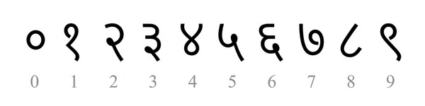
Handwritten Marathi Digit Recognition Using CNN And Transfer Learning With MobileNetV2
|| Ajay Sudhakar Gande || J०२४१००१ || M.Sc. Data Science ||

Slide 2

Problem Statement
Marathi is spoken by 83+ million people
Very few OCR systems support Marathi script
Manual digit recognition is slow and error-prone
Goal: Build an automated classifier for handwritten Marathi digits (०–९)

Slide 3
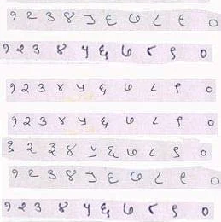

Dataset
Source: Kaggle — Handwritten Marathi Devanagari Characters
1,000 images | 10 classes (one per digit)
100 images per class, 1600×1600 px JPEG
Split: 80% Train (800) / 20% Validation (200)

Slide 4
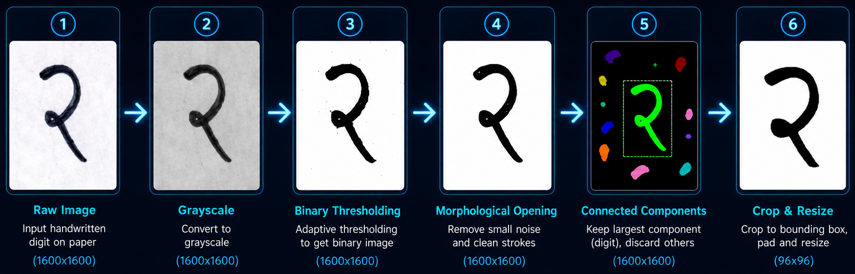
Image Preprocessing
Grayscale Conversion
Adaptive Thresholding (binary image)
Morphological Denoising
Connected Component Analysis (keep largest blob = digit)
Bounding Box Crop + Resize to 96×96

Slide 5
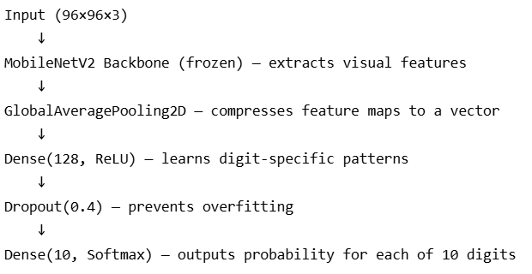
Model Architecture
Backbone: MobileNetV2 (pretrained on ImageNet)❄️ Frozen in Phase 1 | 2,257,984 parameters
Custom Classification Head (trained from scratch)
Parameter Summary
Layer | Details
GlobalAveragePooling2D | Converts feature maps → 1D vector
Dense (128, ReLU) | Learns digit-specific patterns
Dropout (0.4) | Prevents overfitting
Dense (10, Softmax) | Outputs ०–९ probability
 | Count
Total Parameters | 2,423,242
Trainable (Head only) | 165,258
Frozen (Backbone) | 2,257,984

Slide 6
Two-Phase Training Strategy
Why Two Phases? Only 80 training images per class — too few to train from scratch.
Phase 1 — Feature Extraction
Phase 2 — Fine Tuning
Backbone | ❄️ Frozen
Trained | Custom Head only
Learning Rate | 0.001
Epochs | 15 (early stopped)
Best Val Accuracy | 93%
Backbone | 🔥 Last 30 layers unfrozen
Learning Rate | 0.00001 (100× smaller)
Epochs | 5 (early stopped)
Best Val Accuracy | 91%
Data Augmentation Applied in Both Phases
- Rotation ±10° - Width & Height shift 10% - Zoom 10%

Slide 7
Results
Metric | Value
Overall Validation Accuracy | 91%
Best Classes | ०, ४, ५, ८ — 100%
Hardest Class | ६ — 60%
Total Parameters | 2,423,242

Slide 8
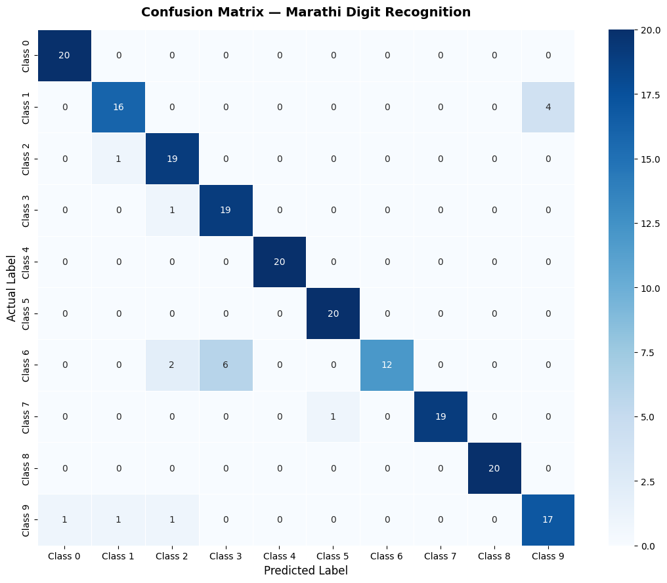
Confusion Matrix
Most errors: ९ misclassified as १ or २
Visual similarity between certain Marathi digits causes confusion

Slide 9
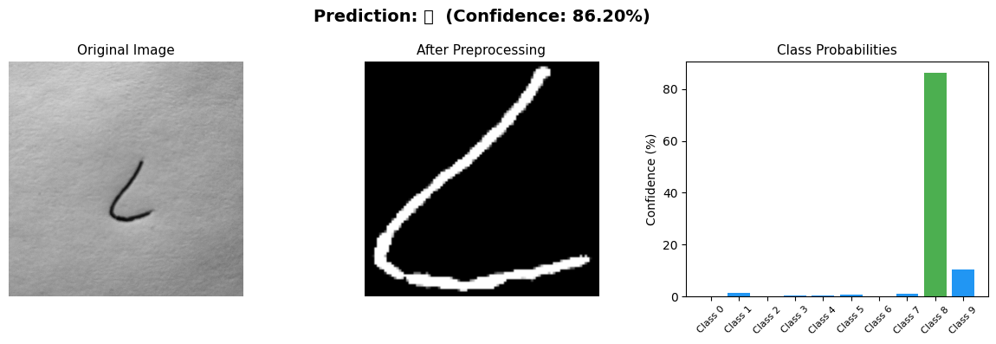
Live Demo How the Model Works in Real Time
Input: Handwritten digit on white paper (photo/scan)
Pipeline:
Image captured → Preprocessing applied
Resized to 96×96 → Fed to MobileNetV2
Model outputs probability for each digit ०–९
Highest probability = Predicted digit
Our Test Result:
Predicted Digit : ८ Confidence : 86.20% Top 3 Predictions: 1. ८ → 86.20% 2. ९ → 10.24% 3. १ → 1.17%

Slide 10
Conclusion
Transfer learning works excellently on small datasets
Preprocessing was the most critical step
90% accuracy with only 80 training images per class

Slide 11
Future Work
Expand to full 48-character Marathi alphabet
Collect more diverse data
Build a TensorFlow Lite mobile app
Try Vision Transformers (ViT)

Slide 12
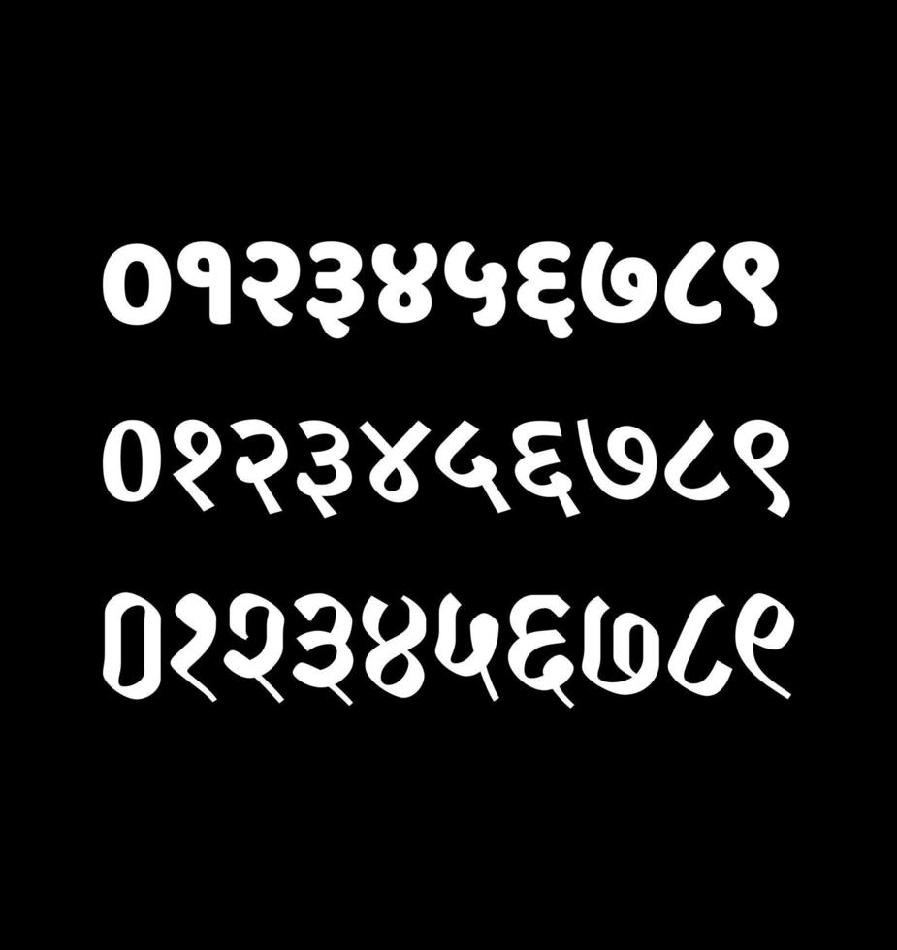
Thank you https://github.com/ajaygande/handwritten-marathi-digit-recognition-using-convolutional-neural-networks-and-transfer-learning./blob/main/handwritten_marathi_digits_cnn_portfolio.ipynb
Ajay Gande | ajaygande1@gmail.com | https://github.com/ajaygande

